Slide 1
Events and Media

Slide 2
Previously, in IMM120
Motion video and objects
Questions?

Slide 3
Download Processing
From processing.org

Slide 4
Events
Functions that run once when they are triggered.
mousePressed is triggered when the mouse is pressed in
Info in mouseX, mouseY
keyPressed is triggered when a key is pressed down
Info in key and keycode
key is the letter typed: “a”, “s”, “w”, “d”, “5”
Common keyCodes: UP_ARROW, DOWN_ARROW, etc., BACKSPACE, ESCAPE, SPACE, SHIFT, TAB

Slide 5
Writing an Event
function mousePressed() {
ySpeed = -10;
}
function keyPressed() {
name = name + key;
}

Slide 6
Images
Source image
Load image
Display image

Slide 7

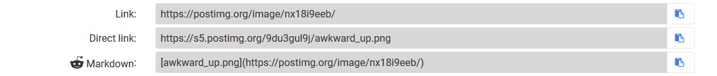
Images
Source image (from a folder or postimage.org)
Load image
Display image

Slide 8
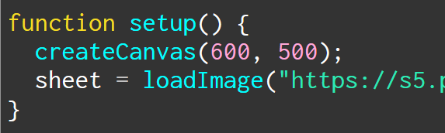
Images
Source image
Load image (make variable, loadImage)
Display image

Slide 9
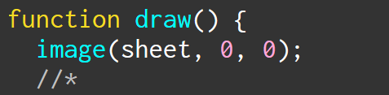
Images
Source image
Load image
Display image (use image command)
x y

Slide 10
Making Memes
Images, fancy text, input, boolean combination

Slide 11
https://postimg.org/gallery/2wrxm8h9w/
All the images for today’s class

Slide 12
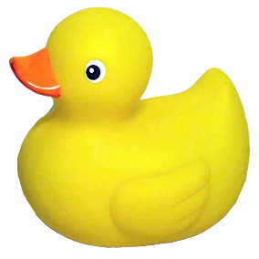
Making Memes
You’re turn to code!
Take the meme images from the gallery
https://postimg.org/gallery/2wrxm8h9w/
Display each meme
Make a mMODE for each meme
Switch from one to the next
I recommend function keyPressed() for this
Notes:
I split the penguin memes in half, don’t worry about it. There’s a good reason for it.

Slide 13
% - modulo
Returns the remainder of simple division
7 % 2 == 2
6 % 3 == 0
3 % 5 == 2

Slide 14
Counting with Modulo
3 % 0 == 0
3 % 1 == 1
3 % 2 == 2
3 % 3 == 0
3 % 4 == 1
3 % 5 == 2
3 % 6 == 0

Slide 15



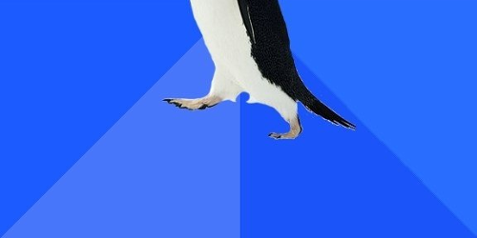
What About These?
Notes:
You may have noticed I split the penguin memes in half…
Make a mode for these real quick

Slide 16
Combining Boolean Ideas
We want to display the upper awesome penguin when:
AWESOME PENGUIN or AWKWARD->AWESOME PENGUIN
Strict boolean logic
AND for when both have to be true (You and I will be there)
OR for when either is true (You or I will be there)

Slide 17


Combining Boolean Ideas
AND → &&
OR → ||
Notes:
pipe

Slide 18
Combining Boolean Ideas
if (mode == mAWESOME || mode == mAWK_AWESOME) {

Slide 19
Combining Boolean Ideas
if (mode == mAWESOME || mode == mAWK_AWESOME) {
IF THIS IS TRUE OR THIS IS TRUE,
execute the contained code

Slide 20
Adding Text
topText = prompt(“TOP TEXT?”);
topText.toUpperCase();

Slide 21
Spritesheets
Animated images
Notes:
GIFs don’t work easily
Sprites are the way to go

Slide 22
https://www.piskelapp.com
A free, online spritesheet drawing

Slide 23
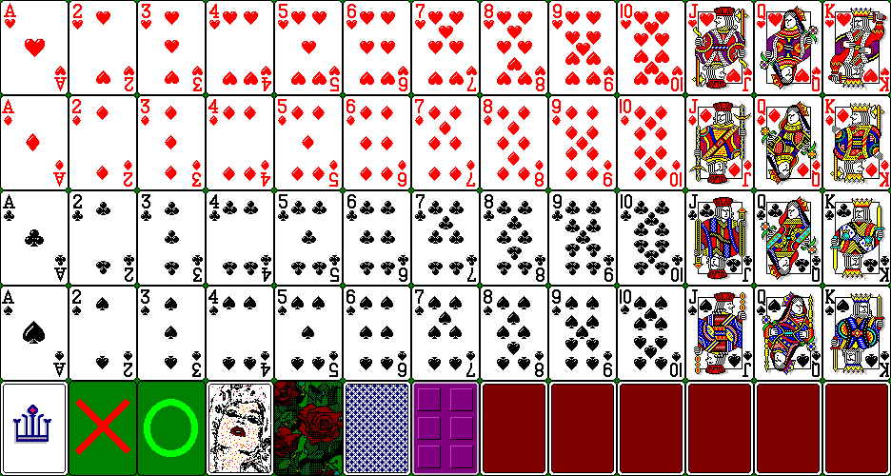

Slide 24
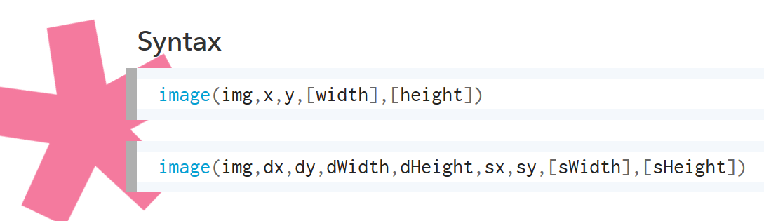

Slide 25
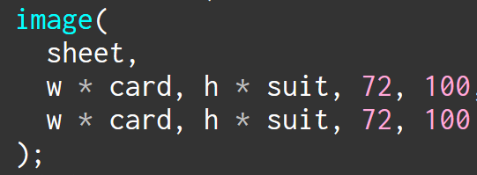

Slide 26
72 times the card you want
0 72 144 216 288 360 432
Notes:
Notice that we start at 0 here

Slide 27
0
100
200
300
100 times the suit you want
Notes:
Notice that we start at 0 here

Slide 28
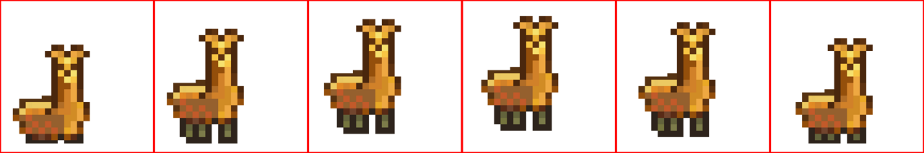

Slide 29
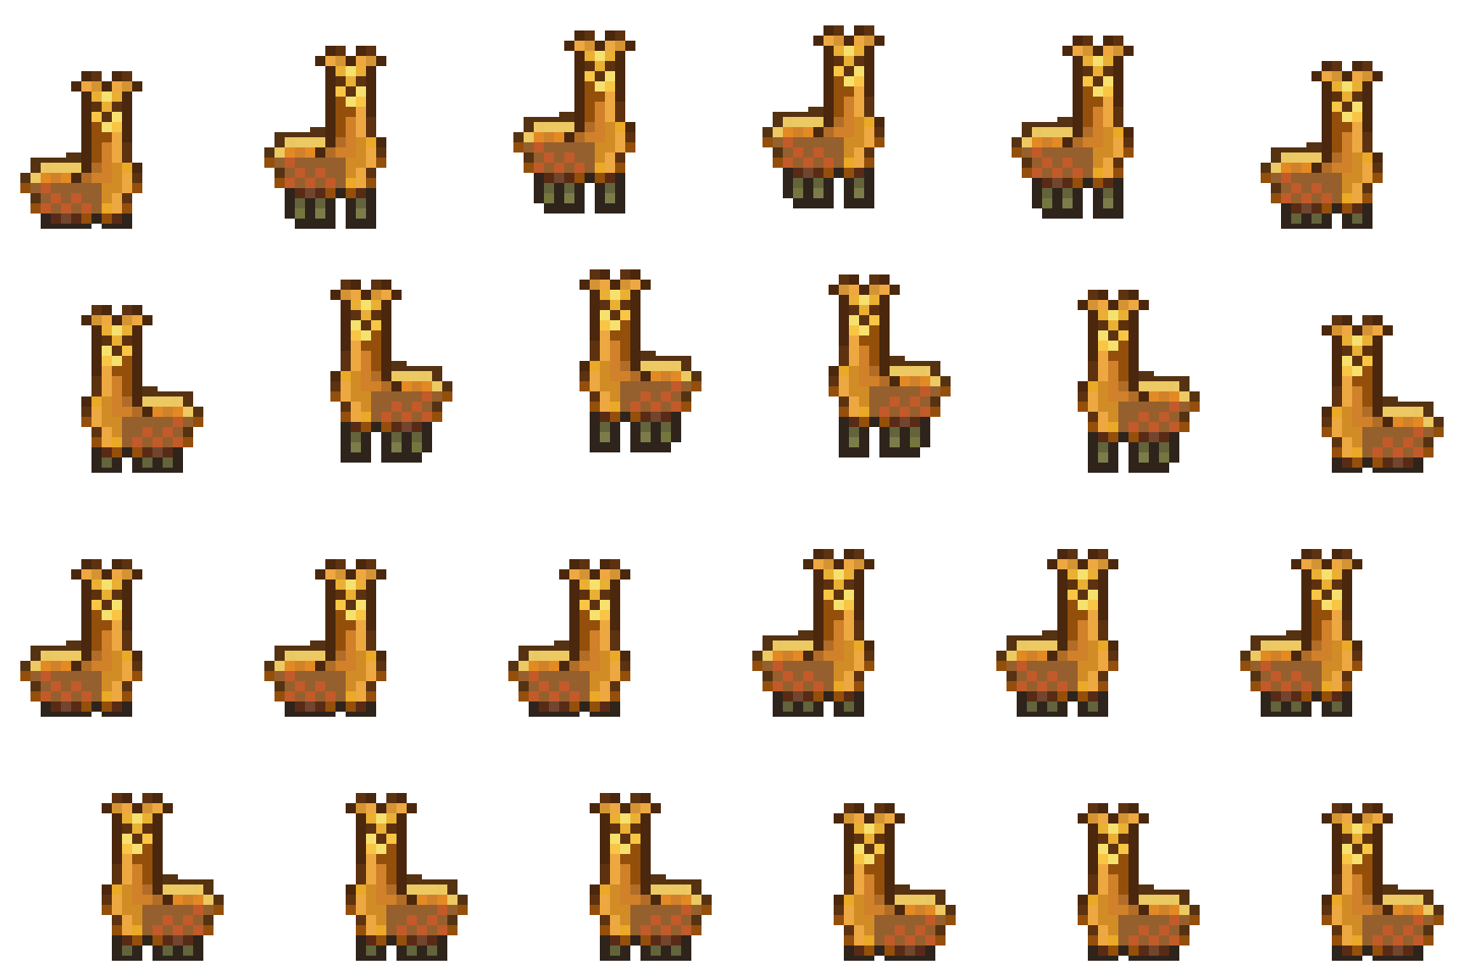

Slide 30
Bouncing right
Bouncing left
Standing right
Standing left

